Slide 1
Trusted Digital Web and the Decentralized (DID) OSI Model 0.9 – January 15, 2022
Enterprise Architecture Domains
Extended OSI Model
Trusted Digital Web
Decentralized (DID) OSI Model
Business Domain/Architecture
8. Business
did:bluetoqueproc
Decentralized (DID) Processes
Application
Domain/Architecture
7. Application
did:bluetoqueagent
Decentralized (DID) Agents
6. Presentation
did:object, did:color, did:bluetoquedoc, …
Decentralized (DID) Objects
Technology/Infrastructure
Domain/Architecture
5. Session
Trinity Graph Storage / VDR
Decentralized (DID) Storage
4. Transport
TCP & UDP Protocols
Segments
3. Network
IP (Logical Addressing)
Packets
2. Data Link
Physical Addressing (MAC)
Frames
1. Physical
Binary Transmission
Data Bits

Slide 2
Trusted Digital Web (TDW2022) Information Scopes (based on Social Evolution Model) – 2202-01-23
Unit | Dwelling | Characteristic Information Scope
1. Wanderer, Individual, Contributor | Tent | Personal Thoughts & Memories, Maps, Sketches
2. Party of Explorers, Group, Team | Camp | Oral History, Water Cooler Conversations
3. Family Unit, Clan, Department | Homestead | Family History, Household Knowledge
4. Band, Community, Division | Village | Communal Knowledge, Collective Knowledge
5. Tribe, Society, Company | Territory | Tribal Knowledge, Institutional Knowledge
6. Nation State, Country, Conglomerate | Nation | Common Knowledge
7. Global Co-operative of Nations (GCN) | Global | All Global Knowledge across All Languages and Repositories

Slide 3
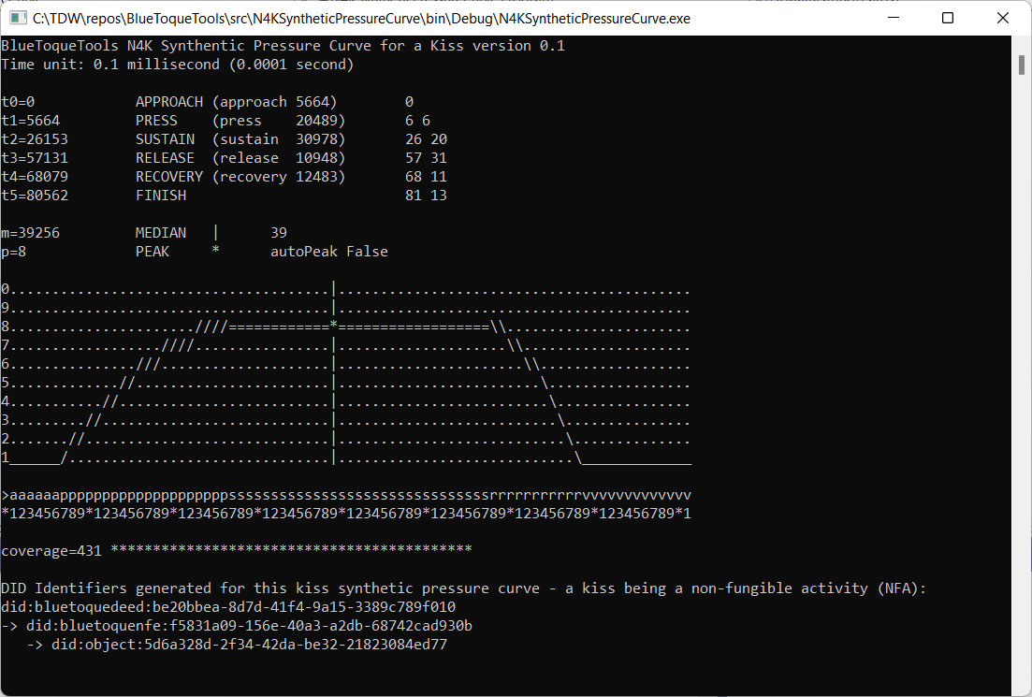
New DID Entity Class: Activity
In addition to People, Organizations, and Things, there is a (new) 4th class of DID Entity
…and, as a result, potentially other new classes of DID Entities waiting to be discovered
4th new class: Activity (Non-Fungible Activity)
An Activity is different from a Thing
An Activity is a self-contained (usually historical) sequence or time series of measurable, closely correlatible, distinct steps
Examples
Kiss’s 6 steps: Approach, Press, Sustain, Release, Recovery, and Finish
Car Crash, Hug, 5-course Dinner, a Belch, an Infection, a Surgery, Throw of a Bowling Bowl, Baseball Pitch, Trajectory of a Football or any Projectile, …
Non-examples
Criminal investigation, Daily stock ticker (e.g. NASDAQ:MSFT), Seismic trace, …

